Slide 1



Song Analysis-Mentorness
View in Power BI
Last data refresh:
7/4/2024 10:46:13 PM UTC
Downloaded at:
7/4/2024 10:50:17 PM UTC

Slide 2
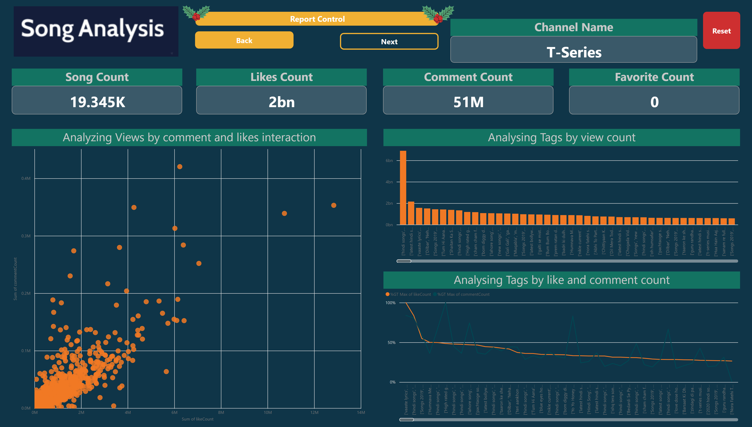
Overview
Notes:
image
No alt text provided
Report Control
No alt text provided
image
No alt text provided
Test
No alt text provided
Test
No alt text provided
Reset
No alt text provided
image
No alt text provided
image
No alt text provided
image
No alt text provided
Song Count
No alt text provided
Likes Count
No alt text provided
Comment Count
No alt text provided
Favorite Count
No alt text provided
Channel Name
No alt text provided
Analyzing Views by comment and likes interaction
No alt text provided
Analysing Tags by view count
No alt text provided
Analysing Tags by like and comment count
No alt text provided

Slide 3
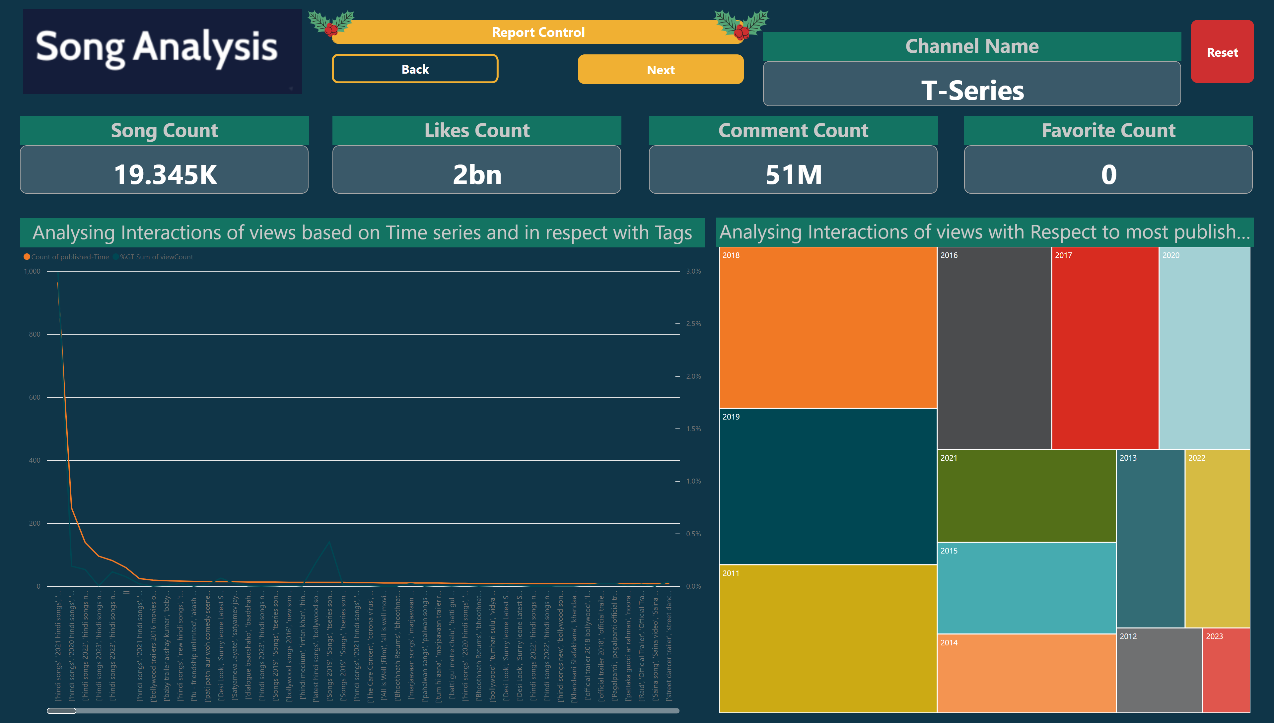
Dashboard 2
Notes:
Report Control
No alt text provided
Test
No alt text provided
Test
No alt text provided
Reset
No alt text provided
image
No alt text provided
image
No alt text provided
image
No alt text provided
image
No alt text provided
image
No alt text provided
Song Count
No alt text provided
Likes Count
No alt text provided
Comment Count
No alt text provided
Favorite Count
No alt text provided
Channel Name
No alt text provided
Analysing Interactions of views based on Time series and in respect with Tags
No alt text provided
Analysing Interactions of views with Respect to most published year
No alt text provided

Slide 4
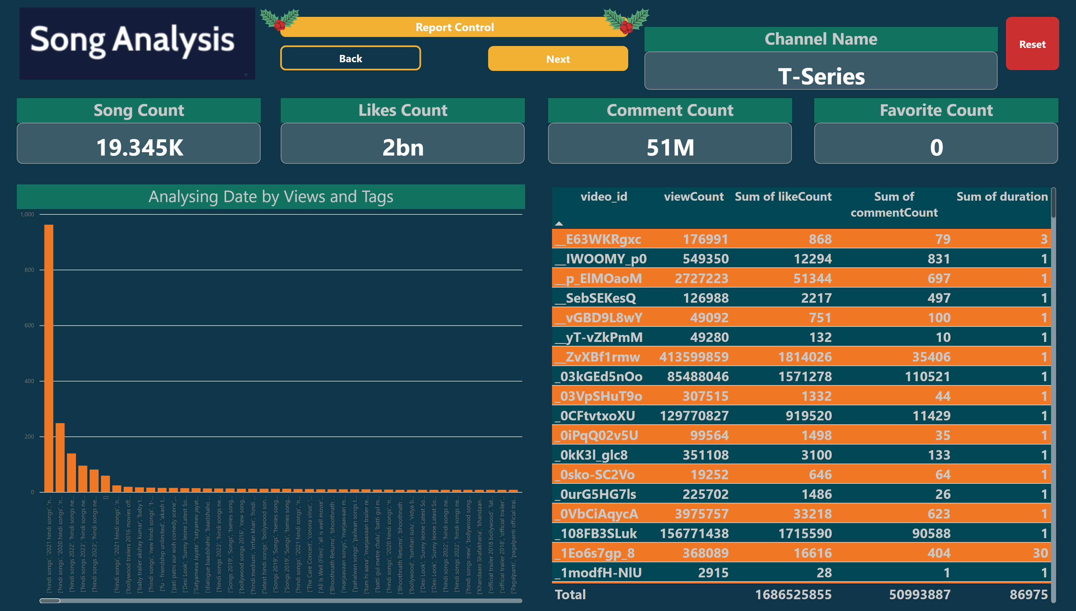
Dashboard 3
Notes:
Report Control
No alt text provided
Test
No alt text provided
Test
No alt text provided
Reset
No alt text provided
image
No alt text provided
image
No alt text provided
image
No alt text provided
image
No alt text provided
image
No alt text provided
Song Count
No alt text provided
Likes Count
No alt text provided
Comment Count
No alt text provided
Favorite Count
No alt text provided
Channel Name
No alt text provided
Analysing Interactions of views with Respect to most published year
No alt text provided
Analysing Date by Views and Tags
No alt text provided

Slide 5
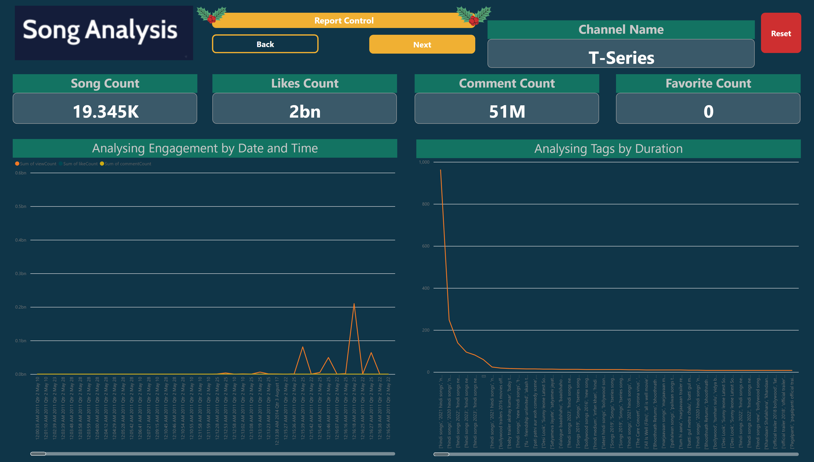
Dashboard 4
Notes:
Report Control
No alt text provided
Test
No alt text provided
Test
No alt text provided
Reset
No alt text provided
image
No alt text provided
image
No alt text provided
image
No alt text provided
image
No alt text provided
image
No alt text provided
Song Count
No alt text provided
Likes Count
No alt text provided
Comment Count
No alt text provided
Favorite Count
No alt text provided
Channel Name
No alt text provided
Analysing Engagement by Date and Time
No alt text provided
Analysing Tags by Duration
No alt text provided

Slide 6
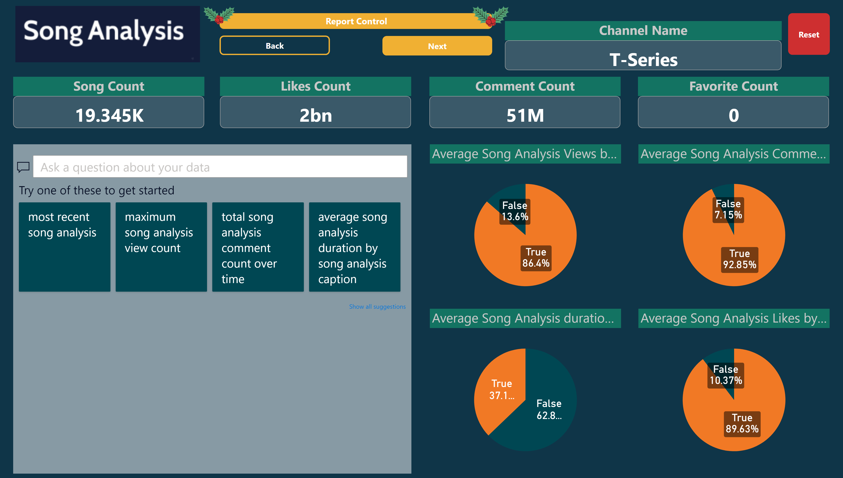
Dashboard 5
Notes:
Report Control
No alt text provided
Test
No alt text provided
Test
No alt text provided
Reset
No alt text provided
image
No alt text provided
image
No alt text provided
image
No alt text provided
image
No alt text provided
image
No alt text provided
Song Count
No alt text provided
Likes Count
No alt text provided
Comment Count
No alt text provided
Favorite Count
No alt text provided
Channel Name
No alt text provided
Analysing Engagement by Date
No alt text provided
Average Song Analysis duration by Caption
No alt text provided
Average Song Analysis Views by Caption
No alt text provided
Average Song Analysis Comments by Caption
No alt text provided
Average Song Analysis Likes by Caption
No alt text provided

Slide 7
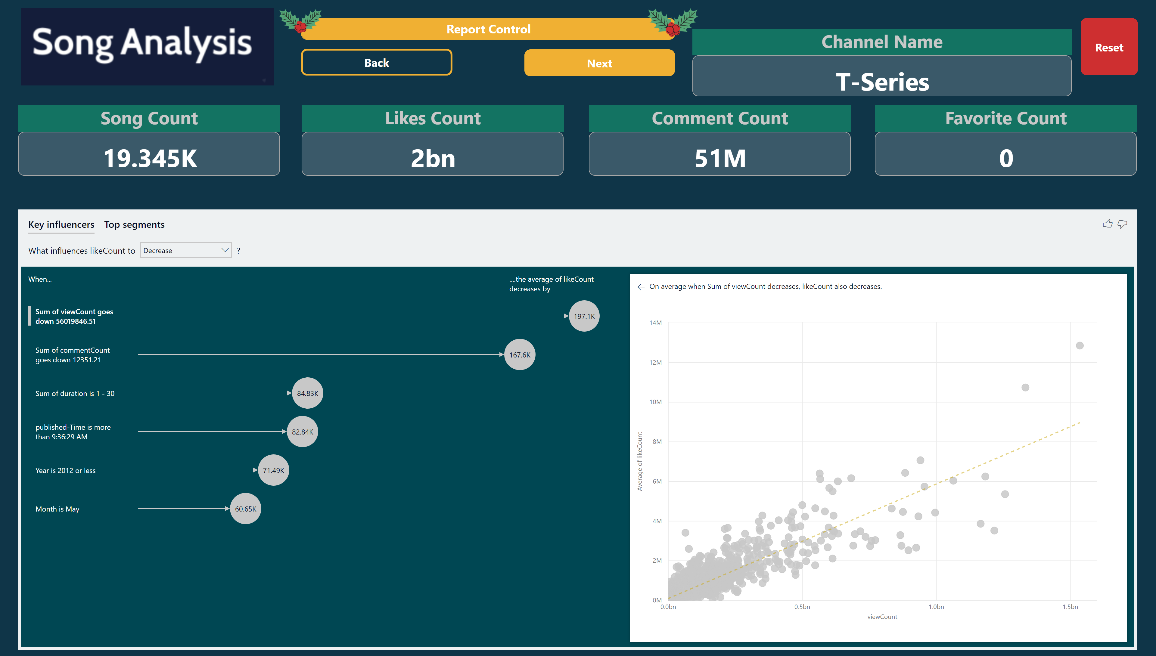
Dashboard 6
Notes:
Report Control
No alt text provided
Test
No alt text provided
Test
No alt text provided
Reset
No alt text provided
image
No alt text provided
image
No alt text provided
image
No alt text provided
image
No alt text provided
image
No alt text provided
Song Count
No alt text provided
Likes Count
No alt text provided
Comment Count
No alt text provided
Favorite Count
No alt text provided
Channel Name
No alt text provided
keyDriversVisual
No alt text provided

